Slide 1
Unit 2

Slide 2
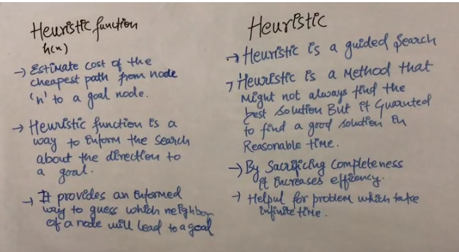
Heuristic

Slide 3
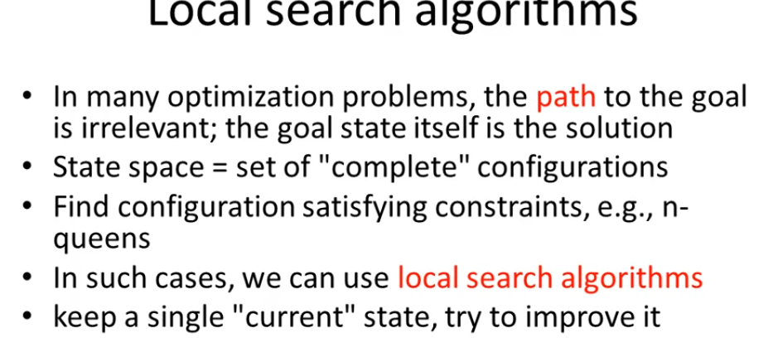
Hill Climbing Algorithm
Hill Climbing is heuristic search used for mathematical optimization problems in the field of Artificial Intelligence . (Given a large set of inputs and a good heuristic function, it tries to find a sufficiently good solution to the problem. This solution may not be the global optimal maximum).

Slide 4
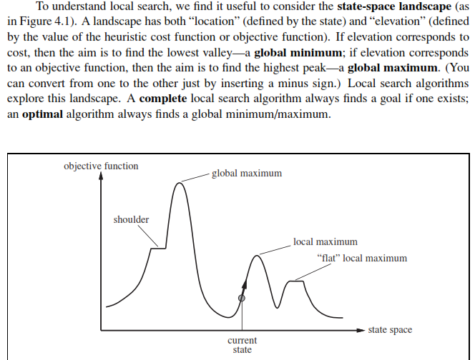

Slide 5
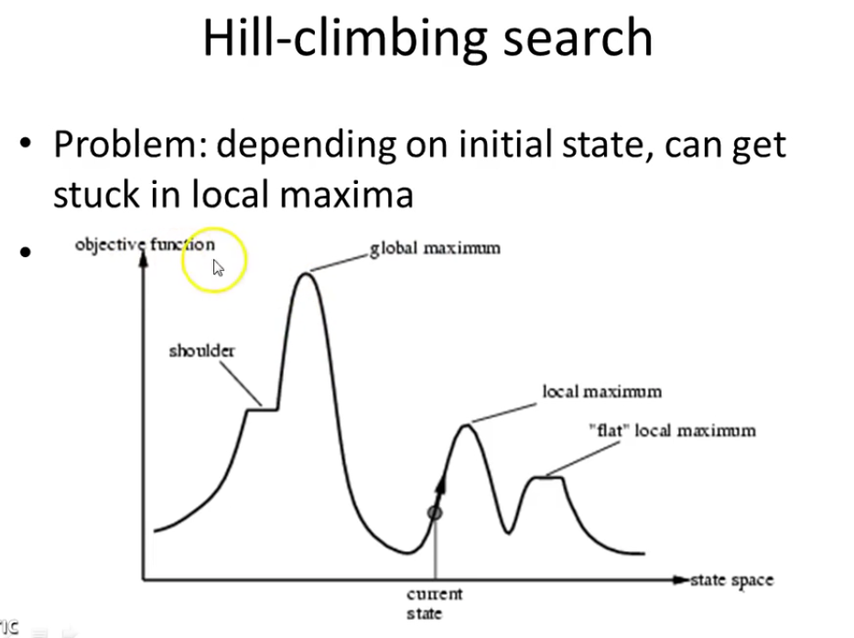

Slide 6
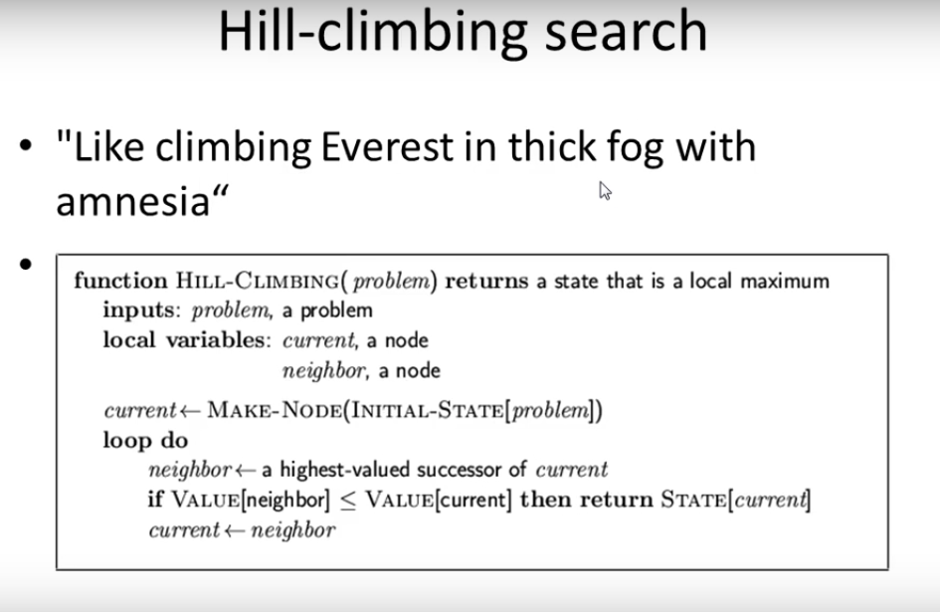

Slide 7
Hill Climbing Algorithm
It is based on Local search algorithms operate using a single current node (rather than multiple paths) and generally move only to neighbours of that node.
Local Search
They use very little memory—usually a constant amount
They can often ﬁnd reasonable solutions in large
inﬁnite (continuous) state spaces for which systematic algorithms are unsuitable.
local search algorithms are useful for solving pure optimization problems, in which the aim is to ﬁnd the best state according to an objective function.
A complete local search algorithm always ﬁnds a goal if one exists.
an optimal algorithm always ﬁnds a global minimum/maximum.

Slide 8
Applications
as integrated-circuit design,factory-ﬂoor layout, job-shop scheduling, automatic programming, telecommunications
network optimization, vehicle routing, and portfolio management.

Slide 9
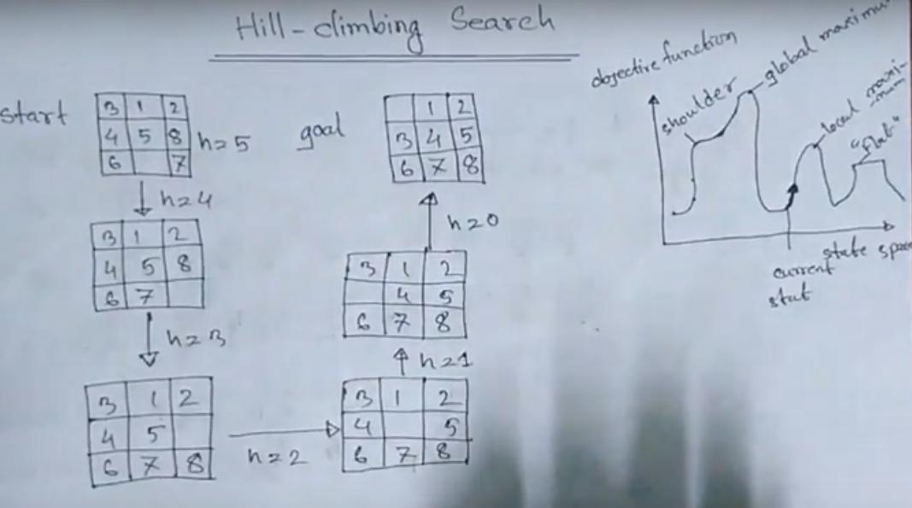

Slide 10
Advantages:
Use very little memory
Can often find reasonable solutions in large or infinite (continuous) state spaces

Slide 11
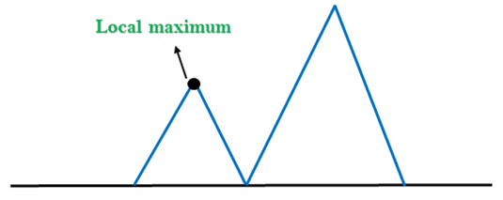
Problems in Hill Climbing Algorithm:
Local Maximum: A local maximum is a peak state in the landscape which is better than each of its neighbouring states, but there is another state also present which is higher than the local maximum.
Solution: Backtracking technique can be a solution of the local maximum in state space landscape. Create a list of the promising path so that the algorithm can backtrack the search space and explore other paths as well.

Slide 12
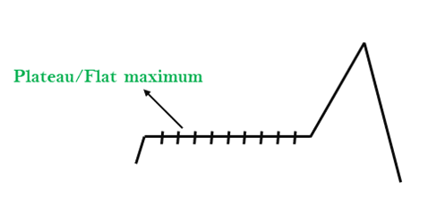
2. Plateau: A plateau is the flat area of the search space in which all the neighbour states of the current state contains the same value, because of this algorithm does not find any best direction to move. A hill-climbing search might be lost in the plateau area
Solution: The solution for the plateau is to take big steps or very little steps while searching, to solve the problem. Randomly select a state which is far away from the current state so it is possible that the algorithm could find non-plateau region.

Slide 13
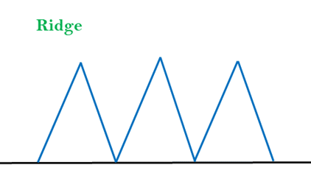
3. Ridges: A ridge is a special form of the local maximum. It has an area which is higher than its surrounding areas, but itself has a slope, and cannot be reached in a single move.
Solution: With the use of bidirectional search, or by moving in different directions, we can improve this problem.

Slide 14
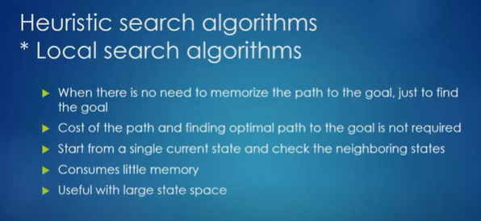

Slide 15
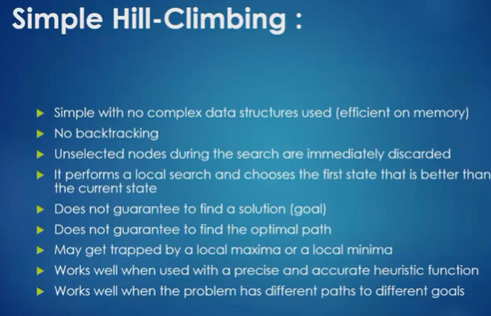

Slide 16
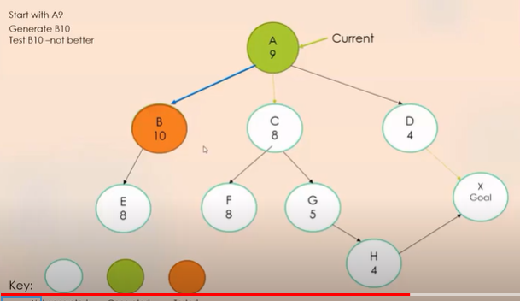

Slide 17
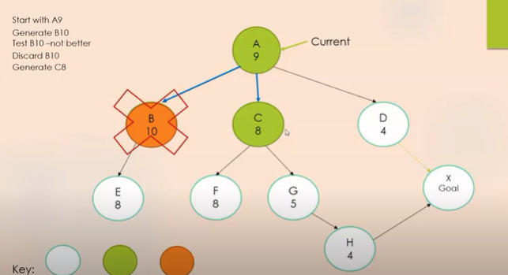

Slide 18
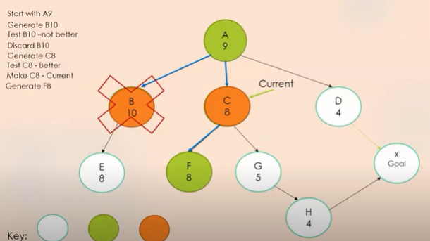

Slide 19
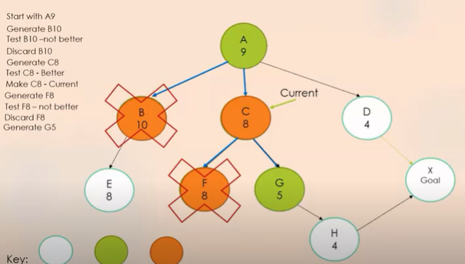

Slide 20
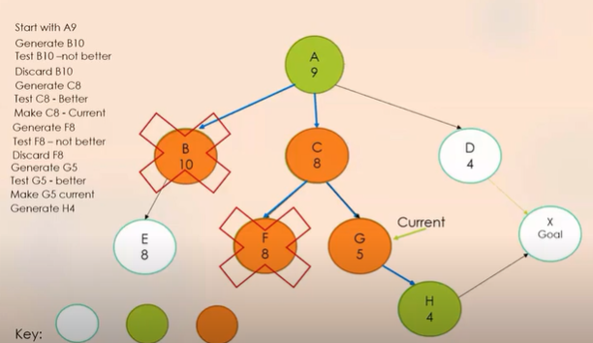

Slide 21
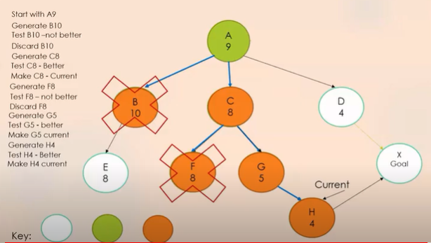

Slide 22
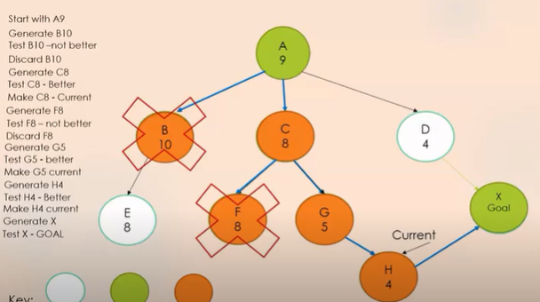

Slide 23
Time and Space Complexity
Hill climbing is neither complete nor optimal.
time complexity of O(∞) .
space complexity of O(b).

Slide 24
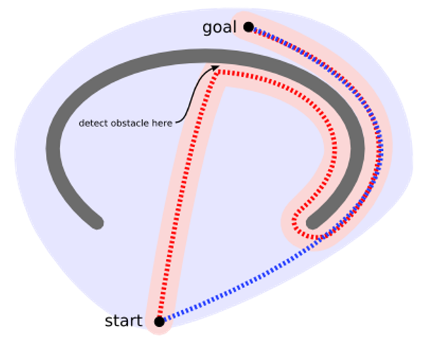
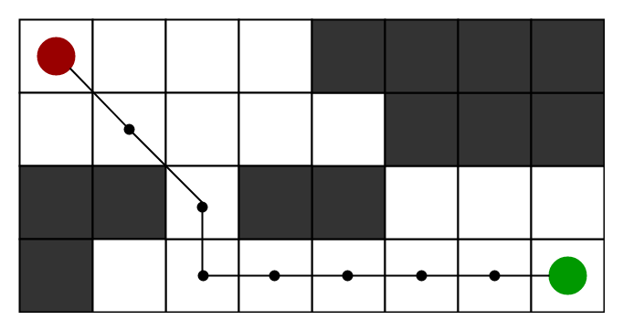
A* Search algorithm
A* Search algorithm is one of the best and popular technique used in path-finding and graph traversals.

Slide 25
What is the A* algorithm?
A * algorithm is a searching algorithm that searches for the shortest path between the initial and the final state. It is used in various applications, such as maps.
In maps the A* algorithm is used to calculate the shortest distance between the source (initial state) and the destination (final state).

Slide 26
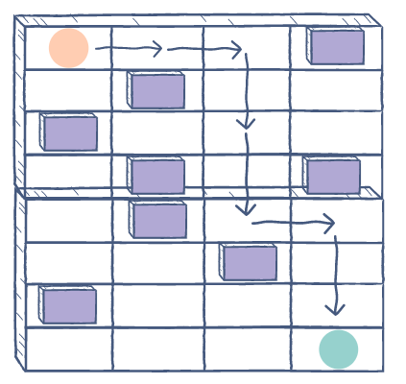
How it works
Imagine a square grid which possesses many obstacles, scattered randomly.
The initial and the final cell is provided.
The aim is to reach the final cell in the shortest amount of time.
Here A* Search Algorithm comes to the rescue:

Slide 27
Explanation
A* algorithm has 3 parameters:
g : the cost of moving from the initial cell to the current cell. Basically, it is the sum of all the cells that have been visited since leaving the first cell.
h : also known as the heuristic value, it is the estimated cost of moving from the current cell to the final cell. The actual cost cannot be calculated until the final cell is reached. Hence, h is the estimated cost. We must make sure that there is never an over estimation of the cost.
f : it is the sum of g and h. So, f = g + h
The way that the algorithm makes its decisions is by taking the f-value into account. The algorithm selects the smallest “f-valued cell” and moves to that cell. This process continues until the algorithm reaches its goal cell.

Slide 28
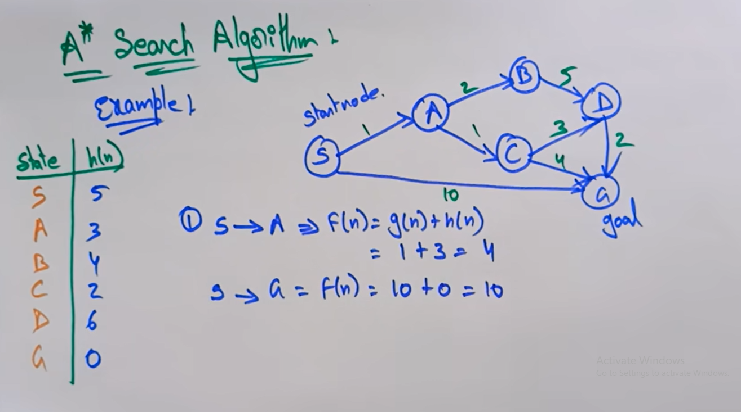
g(n) = cost from the initial state to the current state n.
h(n) = estimated cost of the cheapest path from node n to a goal node. f(n) = evaluation function to select a node for expansion (usually the lowest cost node).

Slide 29
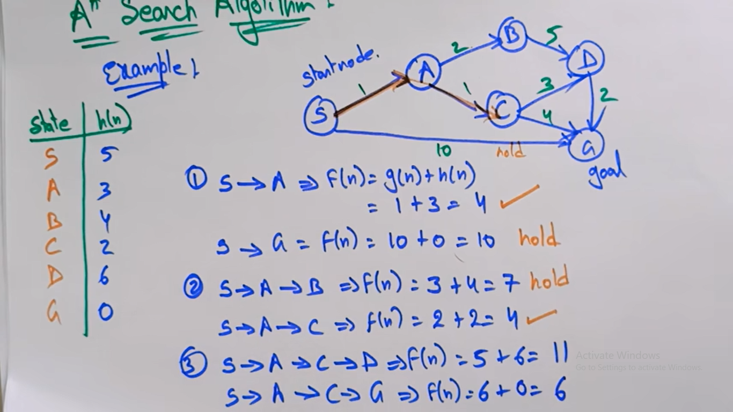

Slide 30
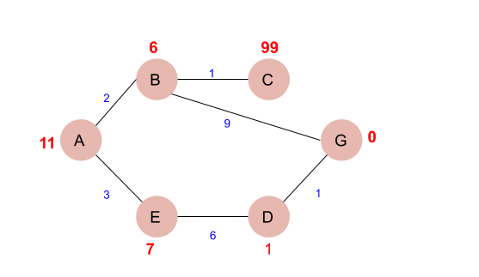
Apply A* Search

Slide 31
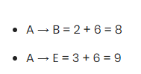
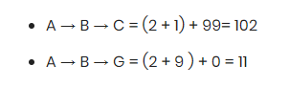

Slide 32
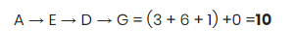

Slide 33
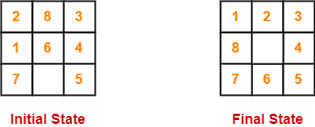

Slide 34
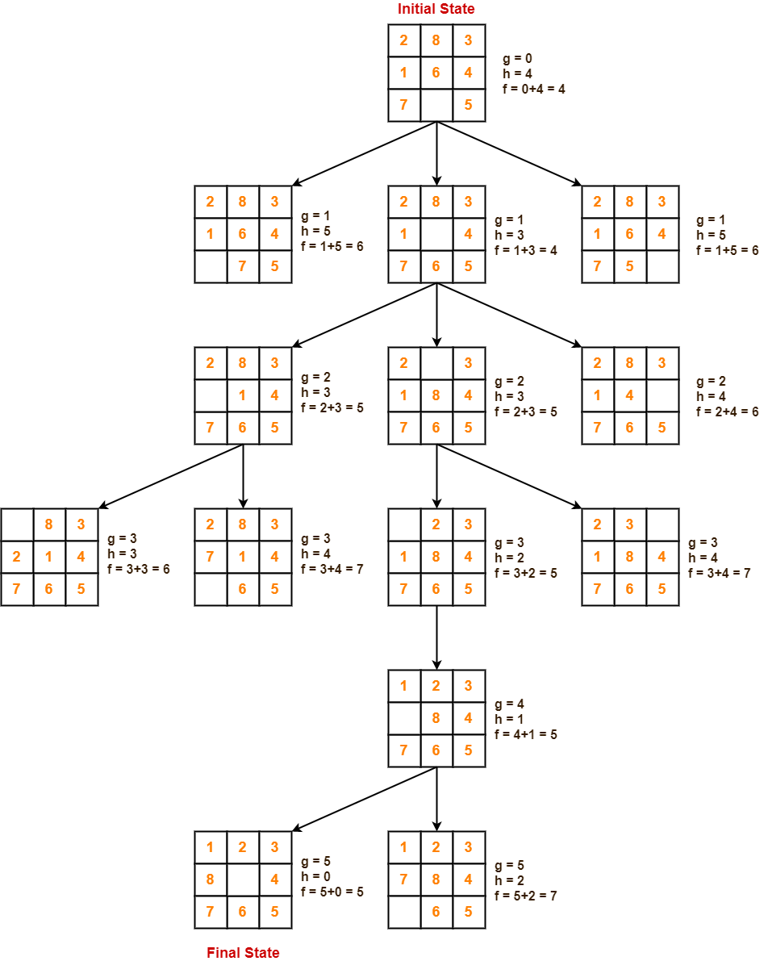

Slide 35
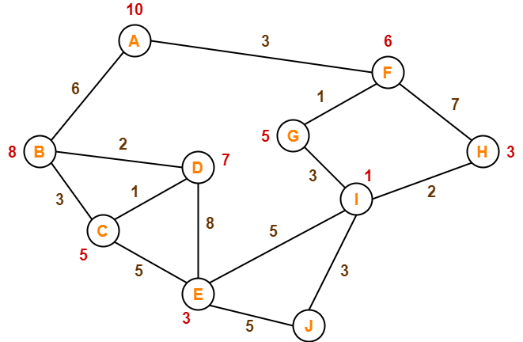

Slide 36
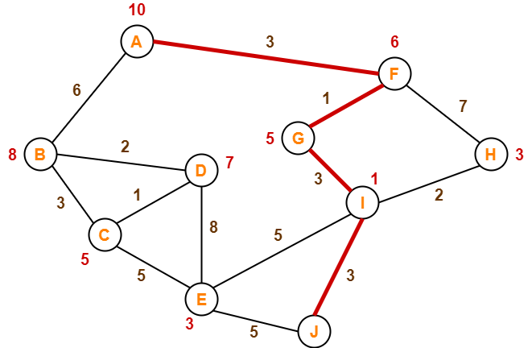

Slide 37
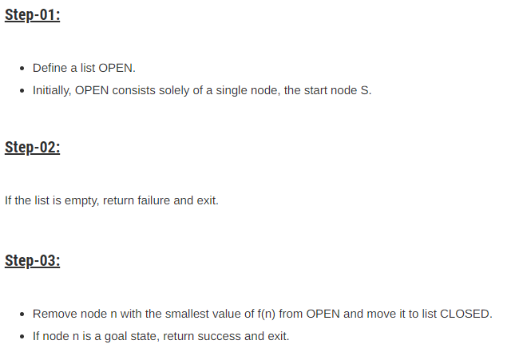

Slide 38
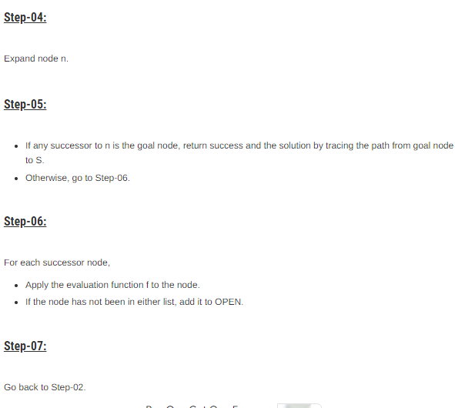

Slide 39
Time and Space Complexity
A* is complete ( iff depth is limited)
time complexity of O(b(pow(d)) .
space complexity of O(b(pow(d))

Slide 40
Best First Search
Best first search is an instance of graph search algorithm in which a node is selected for expansion based o evaluation function f (n).
Traditionally, the node which is the lowest evaluation is selected for the explanation because the evaluation measures distance to the goal.
Best first search can be implemented within general search frame work via a priority queue, a data structure that will maintain the fringe in ascending order of f values.
This search algorithm serves as combination of depth first and breadth first search algorithm.
Best first search algorithm is often referred greedy algorithm this is because they quickly attack the most desirable path as soon as its heuristic weight becomes the most desirable.
Time Complexity : O(B)pow(d)
Space Complexity : O(B) pow(d)
Complete > NO

Slide 41
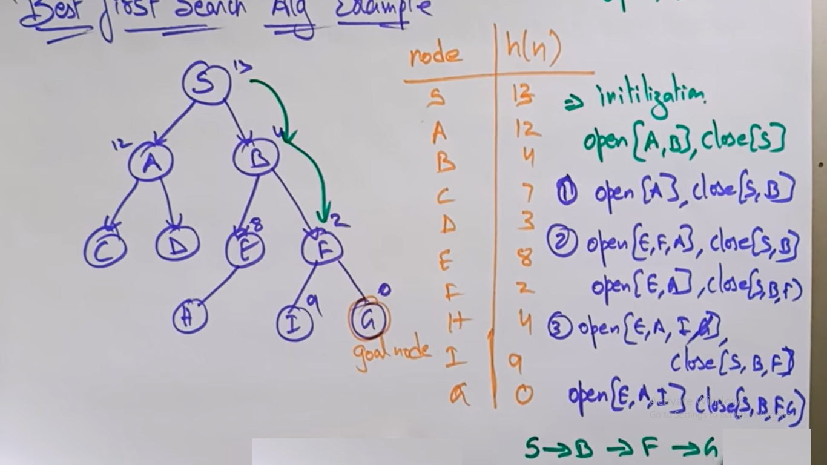
Best First Search

